Slide 1
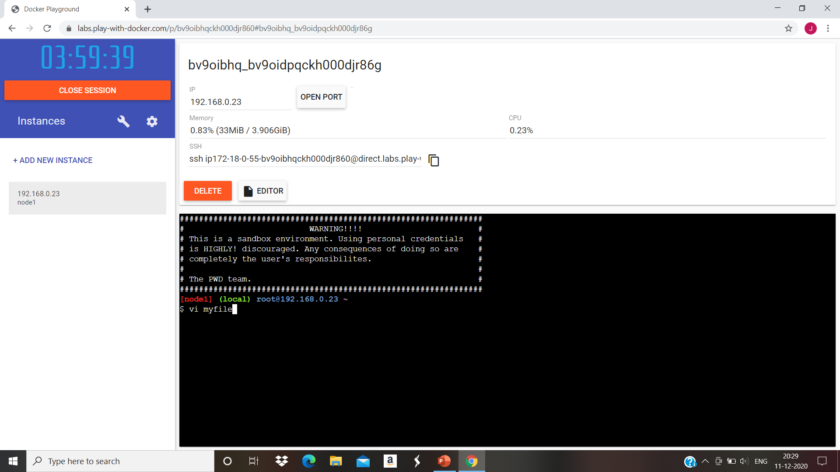
1. Create a Blank file Named “myfile”

Slide 2

2. Open “myfile” in vi editor

Slide 3

Write your Name,Address,Email ID,Phone Number and Blood Group

Slide 4

Build one Single Expression to see the line with Your Name and Blood Group in myfile

